Slide 1
Python Introduction Course
Ronan Paugam

Slide 2
CONTENT
Quick introduction
Practical with Jupyter Notebook

Slide 3

Introduction
Invented in the Netherlands, early 90s by Guido van Rossum
Named after the Monty Python
Open sourced from the beginning
Considered a scripting language, but is much more
The python script (.py extension) is a file containing the commands that are structured to be executed.
But how do you run it?
What do we exactly mean by running a Python Script

Slide 4
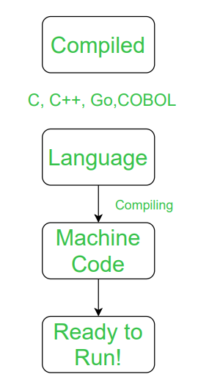
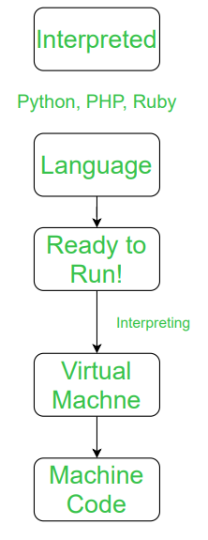
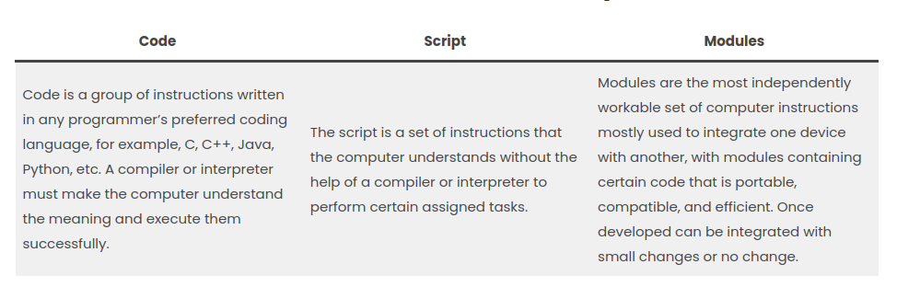
Scripting Language: interpreted vs compiled language
A scripting language is a programming language that is used to manipulate, customize, and automate the facilities of an existing system. Scripting languages are usually interpreted at runtime rather than compiled.
(Wikipedia)
an interpreter is a computer program that directly executes instructions written in scripting language, without requiring them previously to have been compiled into a machine language program.
vs

Slide 5
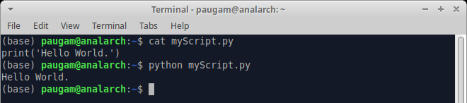
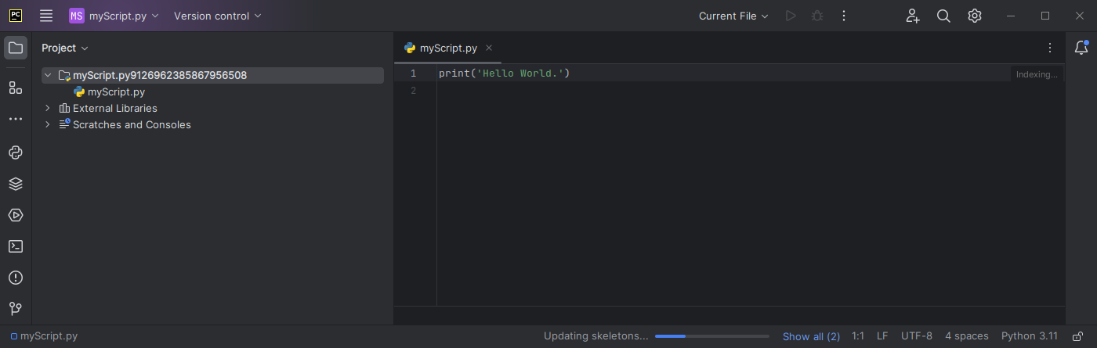
How To run python script
from terminal:
Python is available in all os.
Scripts can be edited with many text editor: e.g. sublime.
from IDE (Integrated development environment Software): example PyCharm
Python interpreter comes with the IDE

Slide 6
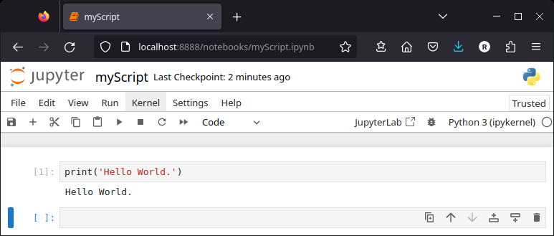
How To run python script
From Jupyter notebook:
Its name and logo are an homage to Galileo's discovery of the moons of Jupiter
A Jupyter Notebook is a browser-based application containing an ordered list of input/output cells which can contain code, text (Markdown syntax), graphics.
Its File extension is .ipynb

Slide 7
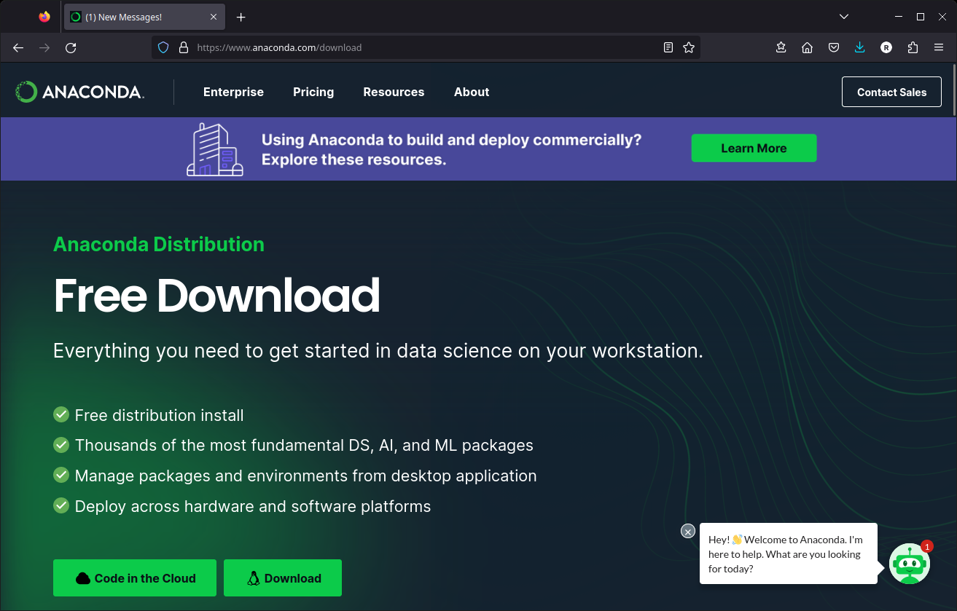
How to install python interpreter:
To install simple python interpreter or jupyter notebook, the easiest way is to install a python environment such as Anaconda.
Anaconda allows to install several side by side environments with selected modules (i.e. librairies). It ensures version compatibilities between modules.
By defaults, anaconda contains a jupyter server.

Slide 8
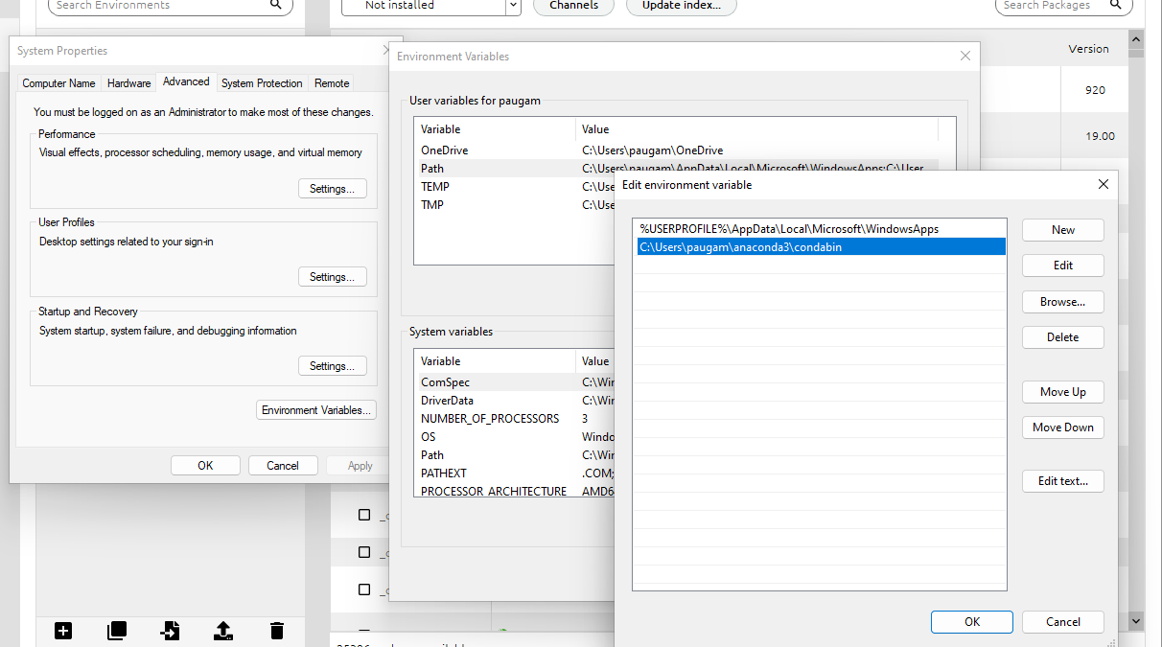
How to install python interpreter:
For the practical you need to install a new environment with dedicated package:
Add new channel: conda-forge
Create new environement:
Add packages:
Numpy
Scipy
Geopandas
Jupyter
Matplotlib
Rasterio
opencv
Install
Add condabin to your os path
From windows menu enter “environement variable”
then add C:\Users\yourUserName\anaconda3\condabin

Slide 9
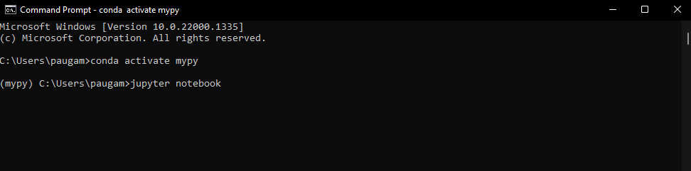
How to start jupyter notebook:
For an ancondac environement named mypy, in a prompt run:
A browser should automatically open.
Then navigate to your notebook (.ipynb) file.

Slide 10
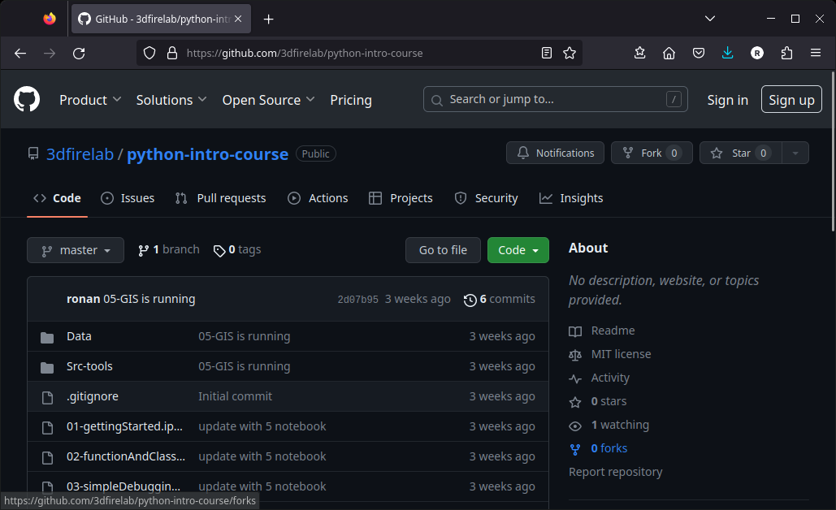
Download Material from github

Slide 11
Practical
01-gettingStarted.ipynb
To get started.
02-functionAndClass.ipynb
Very basic introduction of function and class.
03-simpleDebugging.ipynb
debugging in jupyterLab.
The pdb module
04-usingGit.md
basic usage of git. Git is a version control system that tracks changes in any set of computer files,
05-GIS.ipynb
introduction to module use in Geographical Information System (GIS)
example of homebrewed module
06-pandasExercise.ipynb
An exercise to analyze data in Data/listOfWildFire.csv

